Slide 1


WEB SHOWCASE
TitLE OF PROJECT: DISTANCE LEARNING
TEAM NAME:WEB WIZARDS
Team Leader:
Team Members:

Slide 2
INTRODUCTION OF PROJECT

Slide 3
In this project we have made an informative website about “DISTANCE LEARNING” using HTML and CSS. It gives us information about Distance learning, its advantages and scope in future. As we can observe that due to covid-19 pandemic, whole world is affected and at this time where students cannot be present physically at the school and colleges, with the help ofIn this project we have made an informative website about “DISTANCE LEARNING” using HTML and CSS. It gives us information about Distance learning, its advantages and scope in future. As we can observe that due to covid-19 pandemic, whole world is affected and at this time where students cannot be present physically at the school and colleges, with the help of online distance programs they can still study, which means there is no loss of studies and it’s only because of Distance education. Also people who live in such areas where quality of schools and colleges is bad, can enrol in distance learning programmes and will be taught by some of the best teachers of their field. online distance programs they can still study, which means there is no loss of studies and it’s only because of Distance education. Also people who live in such areas where quality of schools and colleges is bad, can enrol in distance learning programmes and will be taught by some of the best teachers of their field.

Slide 4
SCREENSHOTS OF PROJECT

Slide 5
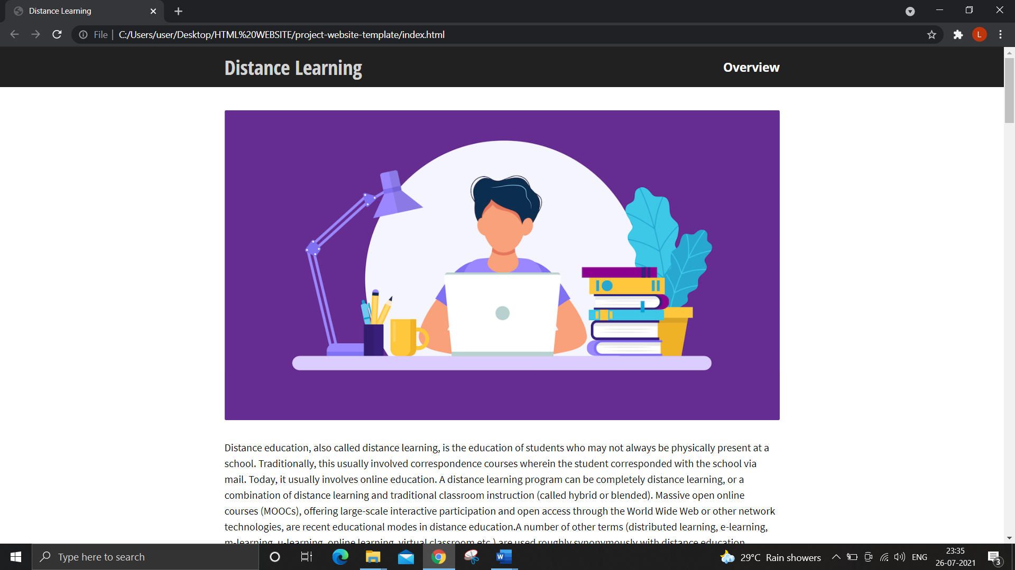
SCREENSHOTS

Slide 6
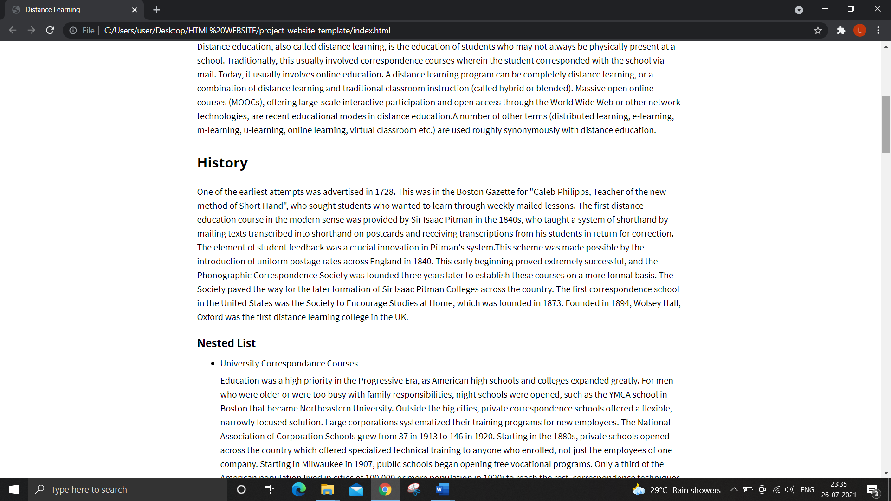

Slide 7
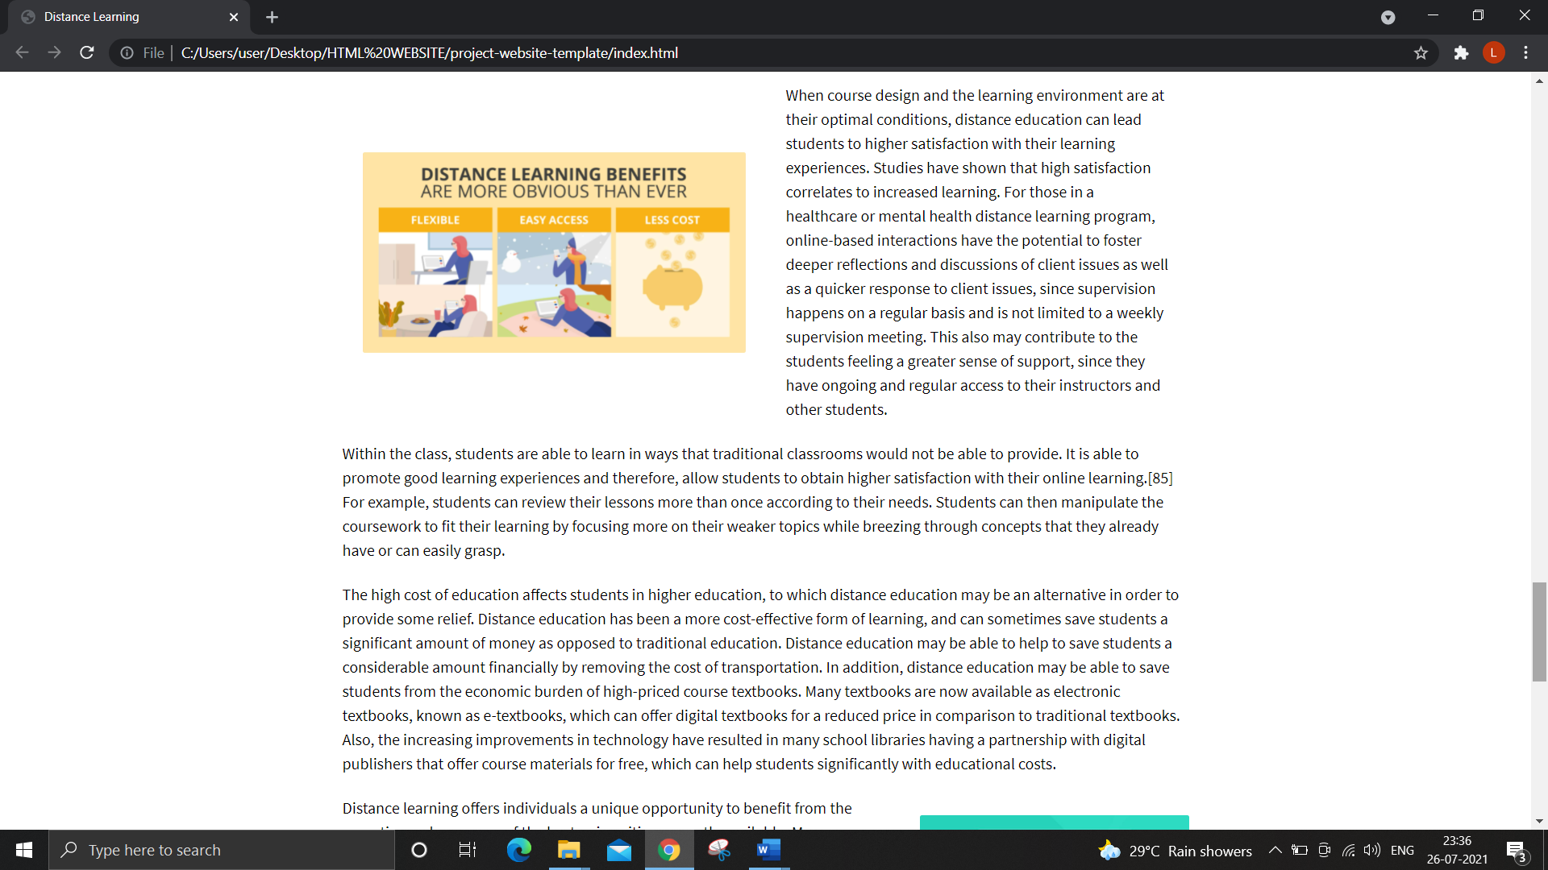

Slide 8
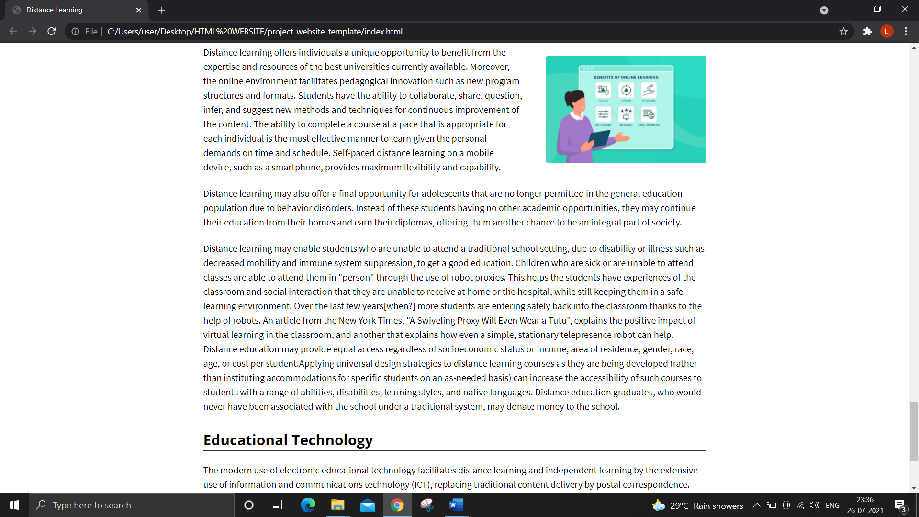

Slide 9
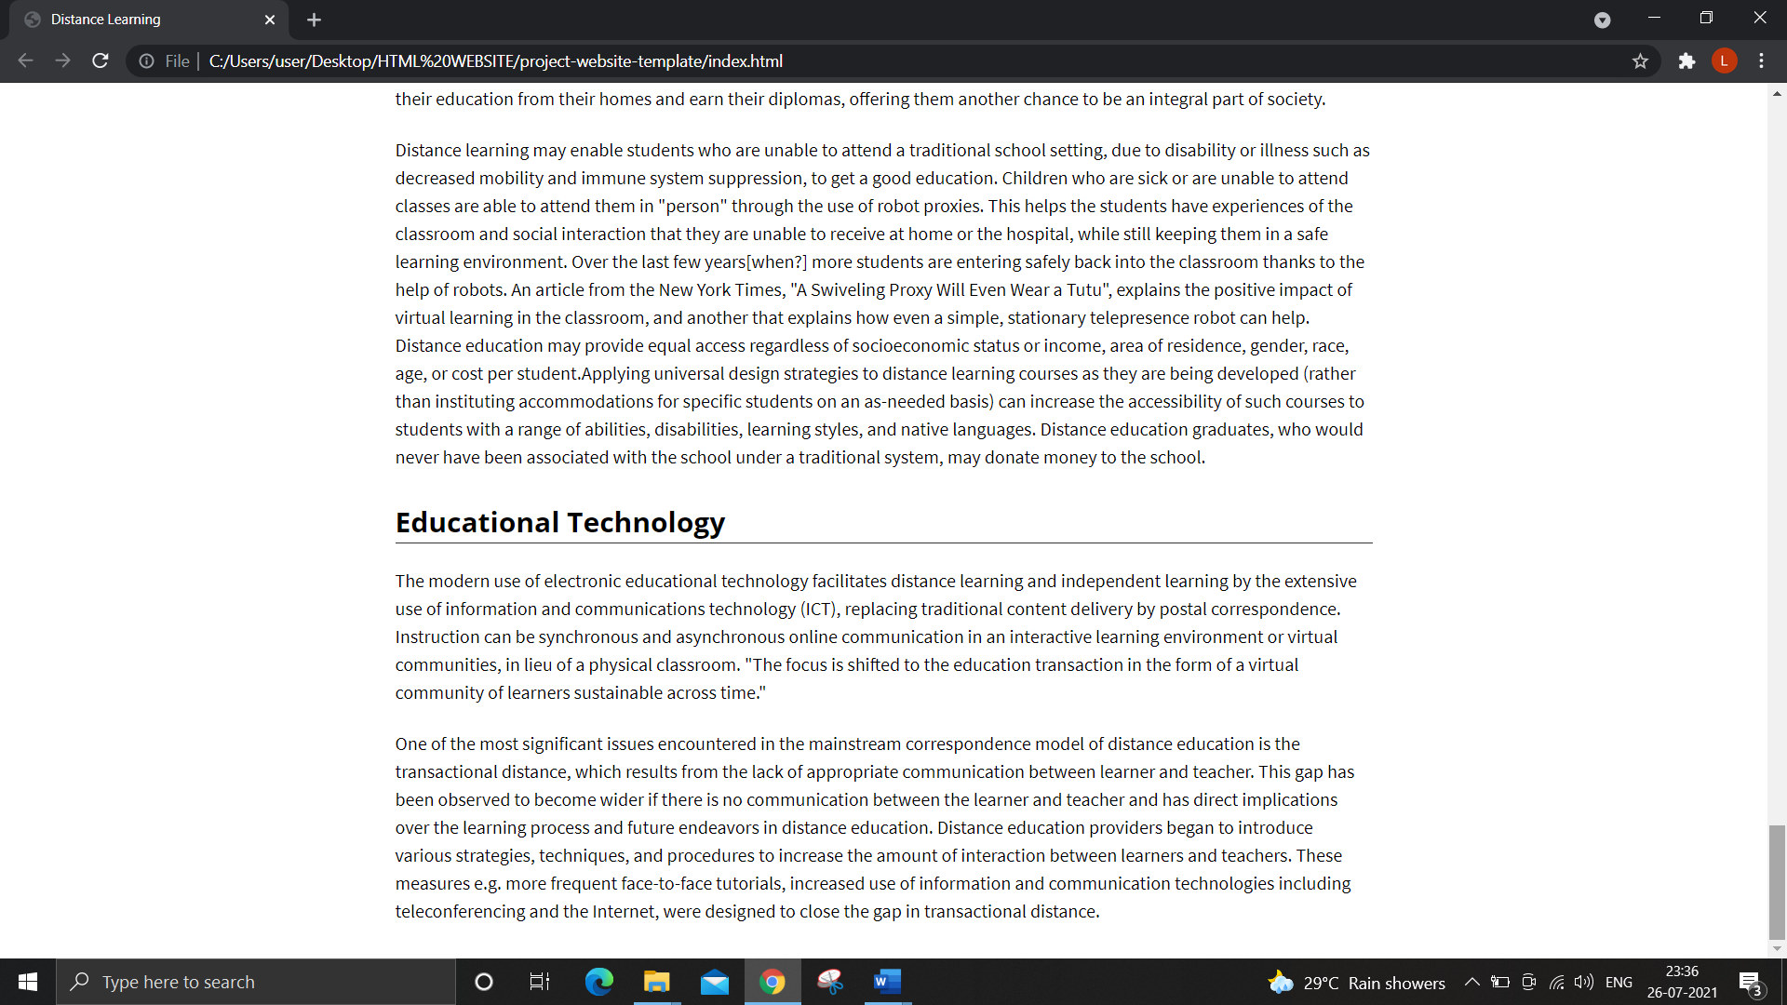

Slide 10
FUTURE SCOPE OF PROJECT

Slide 11
Distance learning is a wide topic. In future, this will expand and we will get to know
many new things or features or technologies. So as for future scope of work, we can expand
our page with more information by adding more pages to it.
We can add videos and audios to it. Also, adding graphs can add more details to it. We can
use javascript or many more languages and can give more styling to make our webpage look
more creative and attractive. We will add links of useful courses from UDEMY,
COURSEERA, NPTEL and UNACADEMY. We will add lectures and notes for learning
different programming languages, GITHUB commands and other technical things which are useful.

Slide 12
THANK YOU!!

